Slide 1
DEPARTMENT OF ELECTRICAL AND ELECTRONICS ENGINEERING
18EEP201L-MINOR PROJECT – II
SECOND REVIEW
Real time river water quality monitoring system
YEAR/ SEMESTER – II/IV
BATCH NUMBER :21
DATE :
GUIDED BY:
S.KIRUTHIKA ASSISTANT PROFESSOR
DEPARTMENT OF EEE
PRESENTED BY:
N.PALANIAPPAN (927622BEE080)
M.SANJANAA SHRI (927622BEE096)
T.PRAVEENA (927622BEE084)

Slide 2
LIST OF CONTENTS
Problem Statement
Objective
Abstract
Block Diagram
Survey Photo
Implementation
Cost Estimation

Slide 3
PROBLEM STATEMENT
Due to the fast growing urbanization supply of safe drinking water is a challenge for the every city authority. Water can be polluted any time.
So the water we reserved in the water tank at our roof top or basement in our society or apartment may not be safe.
Sometimes the water has dangerous particles or chemical mixed and general purpose water purifier cannot purify that.
It’s impossible to check the quality of water manually in every time. So an automatic real-time monitoring system is required to monitor the health of the water.

Slide 4
OBJECTIVE
Remote Sensing Capability: Enable remote sensing and data transmission capabilities to facilitate continuous monitoring across diverse geographical locations, providing a comprehensive view of river health.
Early Warning System: Implement a robust early warning system that utilizes real-time alerts and notifications to promptly identify and communicate potential pollution events or deviations from baseline water quality parameters.

Slide 5
OBJECTIVE
Cost-Effectiveness: Strive to develop a cost-effective solution that balances advanced technology with affordability, ensuring widespread adoption and implementation across different regions and communities.

Slide 6
ABSTRACT
The increasing pressures on freshwater ecosystems necessitate the development of advanced monitoring systems to safeguard water quality. This project proposes the creation of a real-time river water monitoring system that combines cutting-edge sensor technologies, remote sensing capabilities, and data analytics for comprehensive and accurate assessment of key water quality parameters.
The system aims to go beyond traditional monitoring by incorporating sensors for pollutants, heavy metals, and microbial contaminants, providing a holistic view of river health.

Slide 7
DESCRIPTION
The real-time river water monitoring system is a comprehensive solution designed to address the critical need for continuous assessment and management of water quality in river ecosystems.
The system aims to provide an accurate and real-time depiction of key water quality parameters. These parameters include traditional metrics such as pH, dissolved oxygen, turbidity, and temperature, as well as an extended range of sensors for detecting pollutants, heavy metals, and microbial contaminants.

Slide 8
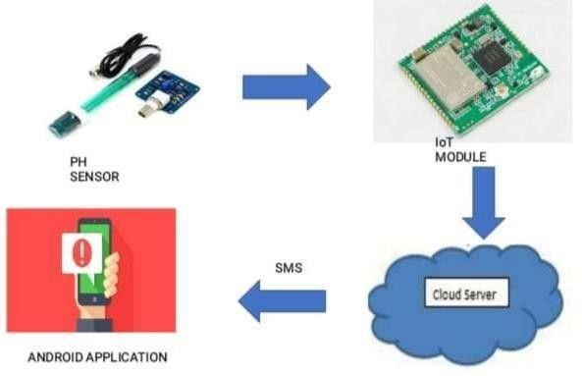
BLOCK DIAGRAM

Slide 9
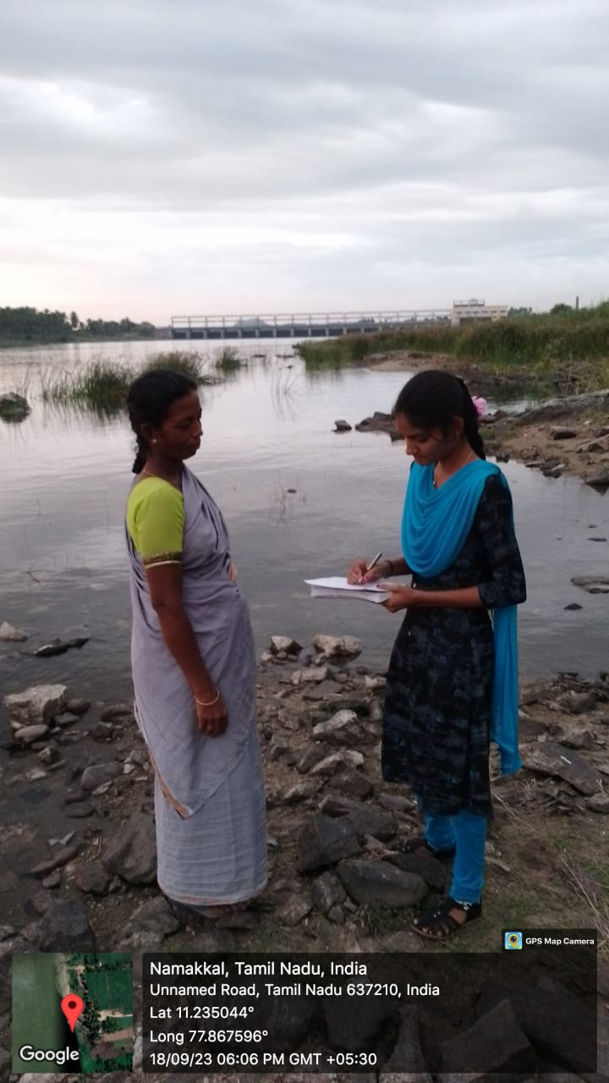
SURVEY PHOTO

Slide 10
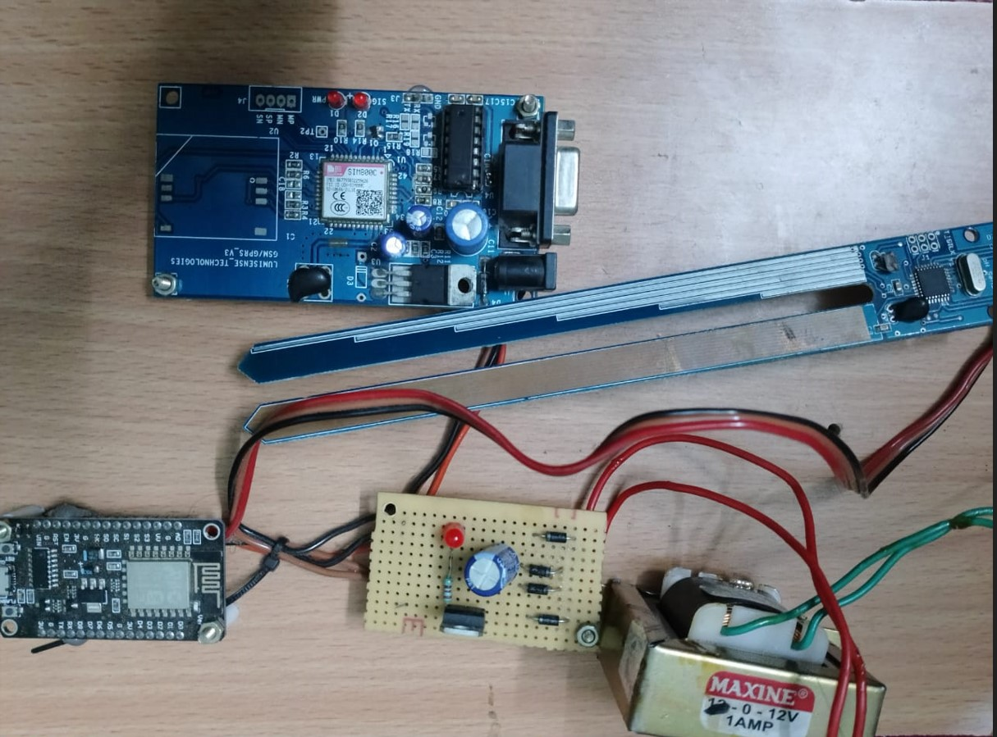
IMPLEMENTATION

Slide 11
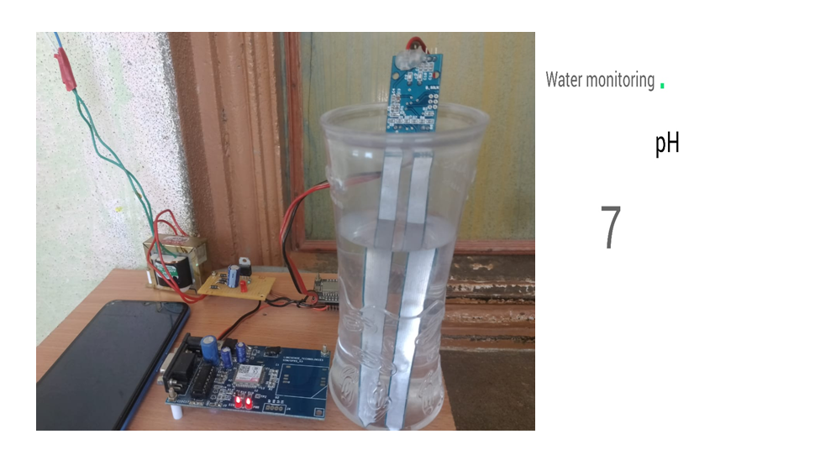
The pH level of water can vary depending on its source and any materials or substance it may contain. Ph level of normal water is 7.

Slide 12
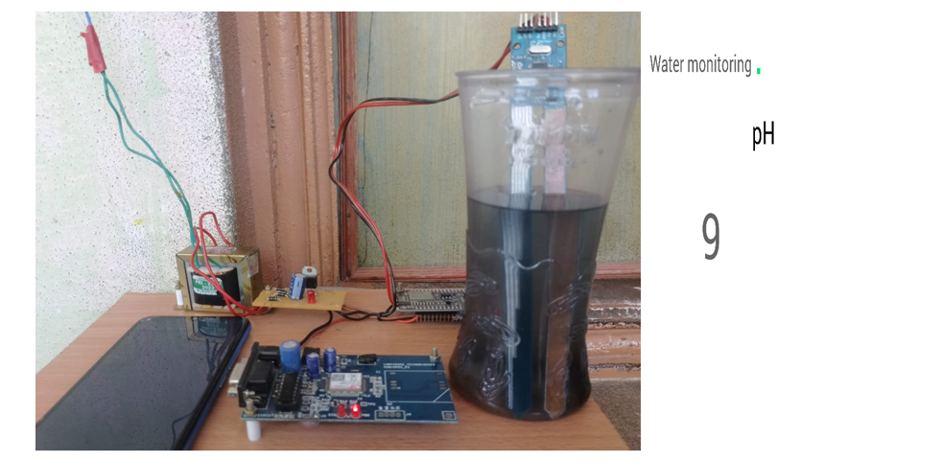
The PH level of an impurity can vary significantly depending on the nature of the impurity itself. For example, if the impurity is a strong acid or base, its PH level could be very acidic (PH < 7) or highly alkaline . However, it’s a weak acid or base, its PH might be closer to neutral.

Slide 13
COST ESTIMATION
S.NO | COMPONENT DESCRIPTION | QUANTITY | COST
01 | Arduino board | 01 | 300
02 | PH Sensor | 01 | 270
03 | Temperature Sensor | 01 | 100
04 | Battery | 01 | 20
 |  | TOTAL | 690

